Slide 1


NATIONAL REFERENCING OF THE KNQF TO THE ACQF
Presentation to the ACQF Delegation | Kenya | 28th – 30th July 2026
Promoting mutual understanding, transparency and comparability of qualifications
Dr. Bulimo Winnie Anne, PhD and Clare Barasa
STRATEGIC ALIGNMENT
Kenya Vision 2030
BETA
Agenda 2063
CESA 2016–2025
AfCFTA
EAC mobility
Supports transparency, trust, learner and labour mobility, recognition of skills and continental comparability.
Notes:
Opening: this presentation is based on the National Referencing Report of the KNQF to the ACQF. It preserves the technical work already prepared while improving accuracy, report coverage and the flow for the ACQF delegation. Emphasise Kenya’s leadership: a legally grounded, outcomes-based, quality-assured and digitally supported framework.

Slide 2


01
CHAPTER-BASED VIEW OF THE REPORT
The referencing report at a glance
The presentation follows the actual logic of the report:
Ch. 1 — National context
Ch. 2 — The KNQF
Ch. 3 — Criterion 1
Ch. 4 — Criterion 2
Education & training system; report development; consultation; legal and institutional evolution.
Goals, principles, levels, descriptors, governance, NQD, QAV, implementation and priorities.
Structural comparison; descriptor analysis; similarities, differences and direct level correspondence.
Learning outcomes; lifelong learning; RPL; KCATS and credit arrangements.
Ch. 5 — Criterion 3
Ch. 6 — Criterion 4
Ch. 7 — Follow-up
QAB recognition; qualification registration; level placement; NQD transparency and verification.
Qualifications quality chain; internal and external QA; standards and continuous improvement.
Endorsement, publication, credential referencing, NQD update, capacity building and monitoring.
Preliminary report outcome: KNQF Levels 1–10 correspond directly with ACQF Levels 1–10, supported by evidence against all four criteria.
Notes:
The presentation mirrors the report's own chapter logic. Seven chapters carry the argument from national context to follow-up. The headline outcome: KNQF levels 1-10 correspond directly with ACQF levels 1-10.

Slide 3
02
NATIONAL OWNERSHIP AND TECHNICAL CREDIBILITY
How Kenya developed the referencing report
The report was developed through a structured, inclusive and evidence-based process coordinated by KNQA and reviewed through national and continental engagement.
1
2
3
4
5
6
KNQA initiation and ACQF engagement
Technical Referencing Committee established
Evidence compiled against four criteria
Drafts presented in ACQF peer forums
National stakeholder validation
Finalisation, submission and implementation
TRC mandate
Stakeholder base
Peer learning
Validation focus
Coordinate referencing; map KNQF descriptors to ACQF; compile evidence; draft and review the report.
Ministry of Education, regulators, QABs, professional bodies, industry, development partners and technical experts.
ACQF webinars, Cluster engagement and forums in Luanda, Nairobi and Seychelles informed revisions.
Strengthened legislation references, QA evidence, NQD evidence, level correspondence and implementation arrangements.
Kenya is presenting a nationally owned and continentally peer-informed referencing report.
Notes:
Stress national ownership. A structured, inclusive, evidence-based process coordinated by KNQA, tested in ACQF peer forums, and validated nationally.

Slide 4
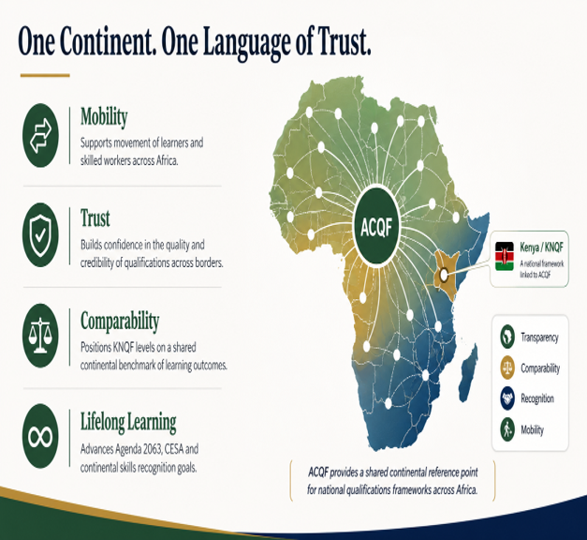
03
REFERENCING TRANSLATES NATIONAL LEVELS INTO CONTINENTAL UNDERSTANDING
Why referencing matters
For learners
For employers and regulators
Clearer progression, mobility and recognition of learning across institutions, pathways and borders.
Improved trust in qualification levels, graduate records, authenticity and comparability.
For Kenya
For Africa
A stronger national qualifications ecosystem aligned to labour mobility, internationalisation and development priorities.
A practical example of referencing an NQF to the ACQF through evidence, descriptors, QA and digital records.
Key distinction: referencing supports recognition and comparability; it does not automatically equate every qualification or confer professional rights.
Notes:
Referencing translates national levels into continental understanding. Value for learners, employers and regulators, Kenya, and Africa. Note the safeguard: it supports comparability, it does not auto-equate qualifications or confer professional rights.

Slide 5
04
SYSTEM VIEW — THE LEARNER JOURNEY BEFORE QUALIFICATIONS ARE CLASSIFIED
Kenya's education and training system: pathways and progression
Kenya's education and training system provides structured routes from foundational learning to tertiary, professional and occupational pathways.
Early Years
Basic Education
Senior School
Post-Basic Edu. Routes
Pre-primary learning
›
Primary & Junior School
›
Pathway selection
›
Tertiary, professional & industrial training pathways
Age 2+; foundational competencies
Levels 1–2
Level 3
Levels 4–10
FIVE REGULATED EDUCATION AND TRAINING PATHWAYS
Basic Education
TVET
Uni. Education
Prof. Education
Industrial Training
DQAS / KNEC / KICD
TVETA / TVET CDACC
CUE
Professional bodies
NITA
School education and national assessment
Technical and vocational learning
University and postgraduate qualifications
Practice standards, licensing and CPD
Workplace skills, trade testing and apprenticeships
The report first situates the KNQF within Kenya’s actual education and training ecosystem: learners, pathways, regulators and progression routes.
System view: Kenya's multi-agency learning pathways provide the national context for KNQF referencing.
Notes:
Situate the KNQF in Kenya's real education ecosystem first: the learner journey from early years to post-basic pathways, and the five regulated pathways with their regulators.

Slide 6
05
FRAMEWORK VIEW — LEVELS, DESCRIPTORS & QUALIFICATION TYPES
The KNQF architecture: how Kenya classifies qualifications
TEN-LEVEL QUALIFICATIONS MAP
WHAT THE ARCHITECTURE DOES
Level
Representative qualification types
Descriptor emphasis
—
Classifies qualifications across ten levels, from foundational learning to doctoral-level outcomes.
10
Doctorate Degree
Frontier knowledge; original contribution
9
Master's Degree
Mastery, research and advanced practice
—
Uses level descriptors expressed as knowledge, skills and competence.
8
Professional Bachelor's / PG Diploma / Post-professional awards
Advanced specialised knowledge and leadership
—
Locates qualification types across five sub-frameworks in alignment with sub-sectoral purpose.
7
Bachelor's Degree / Higher National Diploma / Professional Qualification
Advanced knowledge and professional responsibility
—
Uses credits and notional hours to indicate learning volume.
6
Diploma / Professional Qualification / NSC V
Specialised knowledge and decision-making
—
Creates the basis for progression, articulation, recognition and ACQF referencing.
5
Craft Certificate / NSC IV
Technical specialisation and autonomy
Important technical distinction
4
Artisan Certificate / NSC III / GTT I
Broad technical skills and quality outputs
Level descriptors determine complexity; credits determine volume. Qualification titles alone do not determine level correspondence.
3
Senior Secondary / NVC II / NSC II / GTT II
Factual/theoretical knowledge and practical tasks
Report position
2
Junior School / NVC I / NSC I / GTT III
Routine skills and limited responsibility
The ACQF does not prescribe qualification titles. Kenya's comparison is therefore based on level descriptors and learning outcomes.
1
Primary & Pre-primary / Basic Skills or Skills for Life
Foundational knowledge and guided responsibility
Framework view: the KNQF translates Kenya's pathways into a common classification and referencing architecture.
Notes:
The framework view. Ten levels, five sub-frameworks, level placement by learning outcomes. Emphasise the technical distinction: descriptors determine complexity, credits determine volume; titles alone do not determine correspondence.

Slide 7
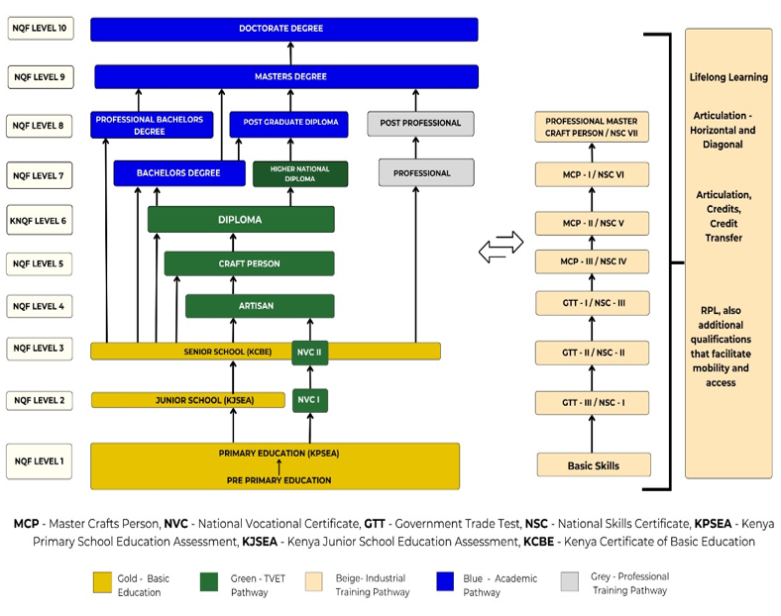
06
HOW MOBILITY IS ENABLED
Progression pathways, RPL and KCATS
Vertical progression
Movement to higher KNQF levels, subject to entry requirements and programme rules.
Horizontal progression
Movement across related fields or sub-frameworks at a comparable level.
Diagonal progression
Movement across both field and level, enabled by RPL, credits and articulation.
Implementation honesty
The report acknowledges that some articulation routes are still evolving, especially between industrial training, TVET and higher education.
Progression is designed into the KNQF, but operational articulation must continue to be strengthened.
Notes:
Progression is designed into the KNQF across three directions. Be candid: some articulation routes, especially between industrial training, TVET and higher education, are still being strengthened.

Slide 8
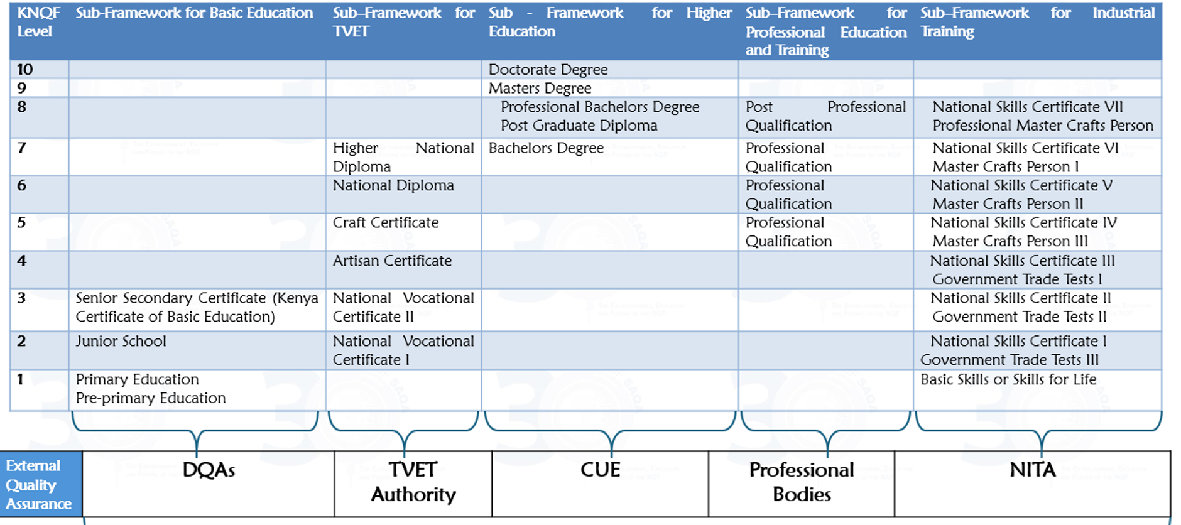
07
KNQF architecture: levels and qualification types
Notes:
A visual restatement of the ten-level map: qualification types rise in complexity from foundational learning at Level 1 to doctoral-level outcomes at Level 10.

Slide 9
08
Governance and implementation evidence
INSTITUTIONAL ECOSYSTEM SUPPORTING THE KNQF
Actor
Core role in the KNQF ecosystem
IMPLEMENTATION EVIDENCE USED IN THE REPORT
Ministry of Education
Policy oversight and education sector coordination
72
2,606
724
Registered QABs reported
Registered qualifications
RPL graduates
KNQA
Develops, maintains, coordinates and implements the KNQF; manages NQD, QAV, RPL/KCATS standards and referencing
NQD
Official register for QABs, qualifications, levels, credits and graduate records.
Sector regulators
CUE, TVETA, NITA and DQAS regulate quality within their sub-framework mandates
KNQCS
Supports classification, naming and coding of qualifications.
QABs and institutions
Develop, deliver, assess and/or award qualifications; submit qualifications and graduate data
QAV Portal
Supports alignment and validation of local and foreign qualifications.
Industry & professional bodies
Support occupational relevance, standards, professional competence and validation
KCATS & RPL
Support learner mobility, recognition of prior learning and credit accumulation.
The report presents both the legal framework and the implementation infrastructure behind Kenya's referencing claim.
Notes:
The institutional ecosystem and the implementation infrastructure behind the referencing claim: 72 registered QABs, 2,606 registered qualifications, 724 RPL graduates, and the digital systems NQD, QAV, KNQCS and KCATS/RPL.

Slide 10
09
ACQF referencing framework: the four criteria
THE TECHNICAL TESTS APPLIED TO THE REPORT
1
2
3
4
Levels and descriptors
Learning outcomes, RPL and credit system
Transparent inclusion and register
Quality assurance system
Clear and demonstrable link between KNQF levels and ACQF descriptors.
Learning outcomes principles linked to RPL and credit system.
Transparent registration procedures and trustworthy, verifiable qualification information.
National QA system connected to the NQF and consistent with ACQF principles.
›
›
Evidence against criteria
›
Level correspondence
›
Governance and follow-up
National context
KNQF architecture
The criteria are interdependent: Criterion 1 establishes level correspondence; Criteria 2–4 demonstrate credibility, transparency and quality assurance.
Notes:
The ACQF applies four technical tests. Criterion 1 establishes level correspondence; Criteria 2-4 demonstrate credibility, transparency and quality assurance. They are interdependent.

Slide 11
10
CRITERION ONE: STRUCTURAL COMPARISON OF KNQF AND ACQF
Dimension | KNQF | ACQF | Finding
Level structure | 10 hierarchical levels | 10 hierarchical levels | Substantially comparable
Descriptor domains | Knowledge, Skills, Competence | Knowledge, Skills, Autonomy & Responsibility | Comparable; different terminology
Purpose | National regulation, coordination, registration & QA | Continental referencing, transparency & comparability | Different mandate
Qualification titles | Specifies national qualification types | Does not prescribe qualification titles | Structural difference
Credit system | KCATS: 1 credit = 10 notional hours | Supports credit approaches but has no single continental credit mechanism | Structural difference
Interpretation
Key basis of comparison
The differences do not prevent referencing. They arise because the KNQF is an operational national framework, while the ACQF is a continental reference framework.
The report compares level descriptors and learning outcomes rather than qualification titles such as certificates, diplomas or degrees.
10
Notes:
This slide directly addresses the accuracy concern. It should not be titled “outcome across four criteria.” It is a Criterion One structural comparison. Use the nuanced ACQF credit wording to avoid suggesting that ACQF opposes credit systems.

Slide 12
11
Criterion one: descriptor comparison methodology
HOW LEVEL-TO-LEVEL CORRESPONDENCE WAS DETERMINED
Comparison area
KNQF expression
ACQF expression
How the report interprets it
Knowledge
Depth, breadth and specialisation of knowledge
Depth, type and complexity of knowledge
Strong conceptual correspondence
Skills
Cognitive, communication, technical and practical skills
Cognitive, practical, technical and communication skills
Strong conceptual correspondence
Competence / autonomy
Competence includes responsibility, judgement and application
Autonomy and responsibility stated explicitly
Different wording; broadly comparable
Progression
Increasing complexity across 10 levels
Increasing complexity across 10 levels
Supports direct level-to-level comparison
Conclusion from methodology
A dominant-fit approach is applied: concepts need not be word-for-word identical where the learning complexity is demonstrably comparable.
Criterion 1 is about learning complexity, not identical wording or identical qualification names.
Notes:
How correspondence was determined: a dominant-fit approach across knowledge, skills, competence/autonomy and progression. Concepts need not be word-for-word identical where learning complexity is comparable.

Slide 13
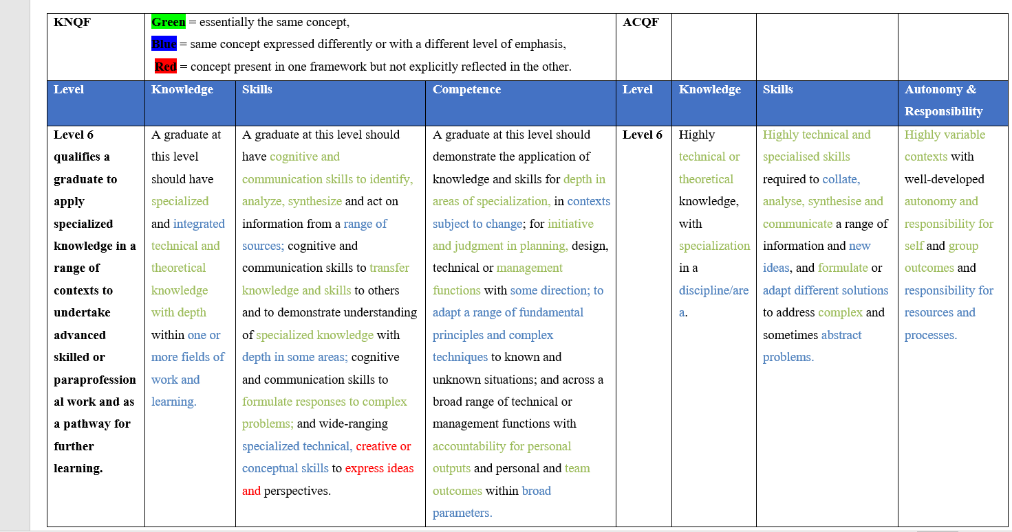
12
REPRESENTATIVE EXAMPLE: KNQF/ACQF DESCRIPTORS- LEVEL 6

Slide 14
13
REPORT FINDING BASED ON DESCRIPTOR COMPARISON
Criterion one finding: direct level correspondence
The report finds that the ten levels of the KNQF correspond directly to the ten levels of the ACQF.
KNQF Level 10
ACQF Level 10
KNQF Level 9
ACQF Level 9
KNQF Level 8
ACQF Level 8
KNQF Level 7
ACQF Level 7
KNQF Level 6
ACQF Level 6
KNQF Level 5
ACQF Level 5
KNQF Level 4
ACQF Level 4
KNQF Level 3
ACQF Level 3
KNQF Level 2
ACQF Level 2
KNQF Level 1
ACQF Level 1
Basis of correspondence
Important safeguard
Implementation link
Comparison of level descriptors across knowledge, skills and competence/autonomy and responsibility.
Direct level correspondence does not mean automatic qualification equivalence or professional licensing rights.
The correspondence is reinforced by Criteria 2–4: outcomes, registration, NQD and QA systems.
12
Notes:
This is the visual centrepiece. Present it confidently but precisely: the report finds direct correspondence between levels based on descriptors, not titles.

Slide 15
14
CRITERION TWO
Learning outcomes, RPL & KCATS
Mechanism
What the report demonstrates
Contribution to referencing
IMPLEMENTATION EVIDENCE: SELECTED RPL FIELDS
RPL
National policy & supporting instruments provides a basis for assessing knowledge, skills and competence acquired outside formal education
Recognises formal, non-formal and informal learning
Engineering
307
Cosmetology
179
Hospitality
79
Fire Technology
73
KCATS
Provides for 1 credit = 10 notional hours; credits may be accumulated and transferred or exempted where criteria are met
Supports mobility, progression and reduced repetition
Catering
34
Reported RPL total
724 RPL graduates across fields; implementation is strongest in occupationally demonstrable fields such as engineering and cosmetology.
Permeability
Entry, re-entry, exit and progression across levels and sub-frameworks
Connects learning pathways to the KNQF structure
Technical precision
RPL, credit transfer and exemption are related but not identical. KCATS provides the credit logic; RPL provides the assessment route.
Other reported RPL fields include Fashion Design, Beauty Therapy, Baking, Hair Dressing, Clothing & Textile and Accommodation.
Notes:
Criterion 2 mechanisms: RPL, KCATS and permeability. Implementation evidence: 724 RPL graduates, strongest in occupationally demonstrable fields. RPL is the assessment route; KCATS provides the credit logic.

Slide 16


15
CRITERION TWO
Learning outcomes
Scope and context
Similarities
ACQF
Broader scope across African countries
—
Purpose: standards, comparability and trust in their scopes
KNQF
Tailored to Kenya's context
—
Integration: embedded in qualifications design, assessment and certification
BOTH
Outcome-based, assessment-based; linked to qualifications design, assessment & QA
—
Application: across all sectors and all forms of learning
—
RPL & credit systems: facilitated in both frameworks
OBSERVATION
KNQF focuses on national needs & standards; the ACQF creates a cohesive framework for qualifications across the African continent, enhancing regional collaboration and recognition.
Notes:
Learning outcomes underpin both frameworks. Same purpose - standards, comparability, trust - integrated into design, assessment and certification. KNQF focuses on national needs; ACQF on a cohesive continental framework.

Slide 17
16
CRITERION TWO
Recognition of Prior Learning (RPL)
RPL in KNQF context
RPL in ACQF context
Providing an alternative access route into a programme of learning, professional designation, employment and career progression; and awarding of credits for, or towards, a qualification or part-qualification registered on the KNQF.
RPL and validation of learning outcomes from experience, for purposes of further study, employment, and acquisition of a full or part qualification. The ACQF supports quality and accessible RPL, as a key component of lifelong learning policies and a mechanism for equity and social inclusion.
Notes:
RPL in both contexts: an alternative access route and a way to award credit toward qualifications. The ACQF frames RPL as central to lifelong learning, equity and social inclusion.

Slide 18
17
CRITERION TWO
Credit systems
Kenya Credit Accumulation and Transfer Systen (KCATS): KNQF
Credit Accumulation and Transfer (CAT): ACQF
—
Policy for Kenya Credit Accumulation and Transfer (KCAT), 2024
—
Key principles of CATS set out in ACQF technical guidance
—
The credit system of one credit = ten notional hours
Source: EN_TM4_Validation and Recognition of Learning_WEB.pdf (acqf.africa)
—
Learners accumulate credits as they complete each component — module, unit, programme, course — of a qualification
—
Promotes a credit system
—
The ACQF supports credit transfer and credit accumulation and transfer systems in different academic and vocational pathways
Notes:
Credit systems: KCATS in Kenya (1 credit = 10 notional hours; accumulate credit per component) and the ACQF's CAT principles supporting credit accumulation and transfer across academic and vocational pathways.

Slide 19
18
FROM QAB ELIGIBILITY TO NQD PUBLICATION
Criterion three: transparent inclusion of qualifications
The report shows that qualifications are included in the KNQF through transparent, quality-assured procedures administered through KNQA and the NQD.
1
2
3
4
5
6
Confirm QAB eligibility and recognition
Programmes developed in alignment with KNQF & accredited by sub-sector regulator
Submitted through NQD portal for registration as NQ
Technical evaluation, validation and level assignment
Approval by KNQA Qualifications Committee
Registration and publication in NQD
Stage
What is checked
QAB recognition
Legal mandate, accreditation status, governance and quality systems
Qualification evaluation
Purpose, learning outcomes, level descriptors, credits, assessment and accreditation evidence
Level placement
Systematic comparison of outcomes with KNQF descriptors
Publication
Registered qualification, QAB, level, credits, outcomes and status available through NQD
Criterion 3 is about a trustworthy process and a trustworthy register.
Notes:
Qualifications enter the KNQF through a transparent, quality-assured six-stage process, from QAB eligibility to NQD publication. Criterion 3 is about a trustworthy process and a trustworthy register.

Slide 20
19
THE NQD AS THE PUBLIC TRUST MECHANISM
Criterion three: NQD, transparency and verification
NQD
The NQD is Kenya's official national register of recognised qualifications and Qualification Awarding Bodies, supporting search, verification and confidence in qualifications.
Registered QABs
Registered qualifications
Graduate records
Awarding bodies with a legal basis.
Qualification title, level, credits and learning outcomes; six-step registration process.
Supports verification of credentials and reduces fraud.
QAV Portal
ACQF linkage
Public confidence
Digital platform for alignment and verification of foreign and local qualifications.
Supports continental comparison and information sharing.
Accessible information for learners, employers, regulators and international stakeholders.
Transparency is what turns level placement into public trust.
Notes:
The National Qualifications Database is Kenya's official register of recognised qualifications and awarding bodies. It supports search, verification and public confidence. Transparency turns level placement into public trust.

Slide 21
20
Transparent procedures for inclusion of qualifications in the NQD
KNQF | ACQF
Policy and Criteria for the Accreditation and Registration of Qualifications and Part-qualifications on the National Qualifications Framework (KNQF) as amended in 2024 & Standards for Alignment and Validation | ACQF policy document underscores the promotion of transparent procedures
A qualification or part-qualification is developed by QAB, industry body, or professional association. The qualification must adhere to national standards for education and training and be aligned with the KNQF’s levels, Descriptors and learning outcomes | Policy documents states that “Qualifications described in terms of learning outcomes will strengthen transparency of learning and trust in qualifications and their outcomes and benefit the country stakeholders as well as those outside the country who are interested in understanding the qualification systems of a given country”
The register of qualifications is available on the KNQAs website, QAV Portal & NQD portal http://nqd.knqa.go.ke or https://knqa.go.ke | Development of QCP

Slide 22
21
A VALUE CHAIN APPROACH TO QUALITY ASSURANCE
Criterion four: quality assurance of qualifications
Kenya's quality assurance system covers the full qualifications awarding lifecycle, from labour market needs and design through delivery, assessment, certification, registration and recognition.
1
2
3
4
5
6
Labour market and occupational standards
Qualification design
Curriculum development and approval
Accreditation and registration
Delivery and assessment
Certification, NQD records and recognition
Internal QA
External QA
KNQF QA role
Continuous improvement
Institutions undertake self-evaluation, assessment moderation, compliance checks and continuous improvement.
CUE, TVETA, NITA, DQAS, professional bodies and KNQA undertake regulation, accreditation, audits and compliance monitoring.
KNQF standards, registration, alignment, validation and NQD publication support system-wide coherence.
Feedback from audits, tracer studies, labour-market information, RPL and NQD data informs review and renewal.
Criterion 4 confirms that referencing is anchored in quality assurance, not only level comparison.
Notes:
Criterion 4: a value-chain approach to quality assurance across the full qualifications lifecycle, with internal and external QA, KNQF's system role, and continuous improvement. Referencing is anchored in QA, not only level comparison.

Slide 23
22
OUTCOME SUMMARY
Preliminary referencing findings against the four criteria
CRITERION | DESCRIPTION | SIMILARITIES BETWEEN KNQF AND ACQF | DIFFERENCES | REMARKS
1. Level Descriptors | There is a clear and demonstrable link between the KNQF/system and the ACQF level descriptors. | Both classify qualifications using level descriptors; semantic alignment around knowledge, skills, competences, autonomy and responsibility; support progression. | ACQF uses 3 descriptor domains; knowledge, skills autonomy, responsibility KNQF uses K/S and C | Not substantive
2. Learning Outcomes Recognition of Prior Learning (RPL) b. Credit Systems | Frameworks are based on learning outcomes principles. | Learning outcomes underpin the KNQF; guide policy and programme design; | No significant differences identified. | No substantive differences
 | Frameworks are based on learning outcomes and include RPL arrangements and, where appropriate, credit systems. | common definition of learning outcomes. Recognition of multiple learning pathways; alternative access routes; employment and career progression. | No significant differences identified. | No substantive differences.
 | Frameworks include arrangements for credit systems where appropriate. 10NH=1 Credit | Use of credit systems; policies supporting credit accumulation and transfer; learner mobility. | No significant differences identified. | No substantive differences.
3. Transparent Procedures for Inclusion of Qualifications / Register | Transparent procedures exist for inclusion of qualifications and information is available through accessible, trustworthy and verifiable national registers. | Well-established websites; NQD and QCP recognition of professional bodies; transparent QA processes. | Differences are mainly in implementation platforms and institutional arrangements. | Not substantive; objectives and principles are aligned.
4. Quality Assurance System | The national quality assurance systems and frameworks are consistent with ACQF quality assurance principles. | Qualifications quality chain/system; clear roles and responsibilities defined in legislation and policies. | No significant differences identified. | No substantive differences.
Direct level correspondence is the Criterion 1 outcome; Criteria 2–4 provide system credibility and implementation assurance.
19
Notes:
This directly fixes the problematic slide. It no longer claims that a structural comparison table represents all four criteria. It cleanly separates the direct correspondence outcome from the supporting credibility criteria.

Slide 24
23
WHAT HAPPENS AFTER SUCCESSFUL REFERENCING
Referencing governance, follow-up and implementation
Follow-up area
Required action / implementation implication
Endorsement and certification
National QA bodies and competent authorities confirm the report and correspondence outcome.
International expert input
Experts provide advisory assurance and strengthen credibility of the process.
Publication
Final report is published nationally and through ACQF channels/platforms.
Credentials and NQD
Newly issued certificates/transcripts and NQD records display KNQF and corresponding ACQF levels after approval.
Capacity building
QABs, regulators, institutions and users receive guidance on the referencing outcome.
Monitoring and review
KNQA monitors implementation and updates the correspondence when frameworks substantially change.
Referencing is not the end of the process; it creates implementation obligations for KNQA, regulators and QABs.
Notes:
What happens after successful referencing: endorsement, expert input, publication, credential referencing, capacity building and monitoring. Referencing creates implementation obligations - it is not the end of the process.

Slide 25

KENYA’S COMMITMENT AND CONTINENTAL LEADERSHIP
Kenya commits to a fully interoperable African qualifications space.
Publish and disseminate
Guide QABs and regulators
Strengthen implementation
Review and improve
Kenya offers a practical model of how an NQF can be referenced to the ACQF through law, evidence, level descriptors, quality assurance and a digital qualifications register.
Notes:
Close on Kenya's commitment to a fully interoperable African qualifications space: publish, guide, strengthen, review. Kenya offers a practical model for referencing an NQF to the ACQF. Invite questions.

Slide 26



& A
4th Floor,NACOSTI Building, off Waiyaki Way, Upper Kabete,
P.O Box 72635 - 00200 Nairobi, KENYA
Website: www.knqa.go.ke Email: info@knqa.go.ke Phone: 0202100272
© 2026 KNQA
ISO 9001:2015 Certified

